Slide 1
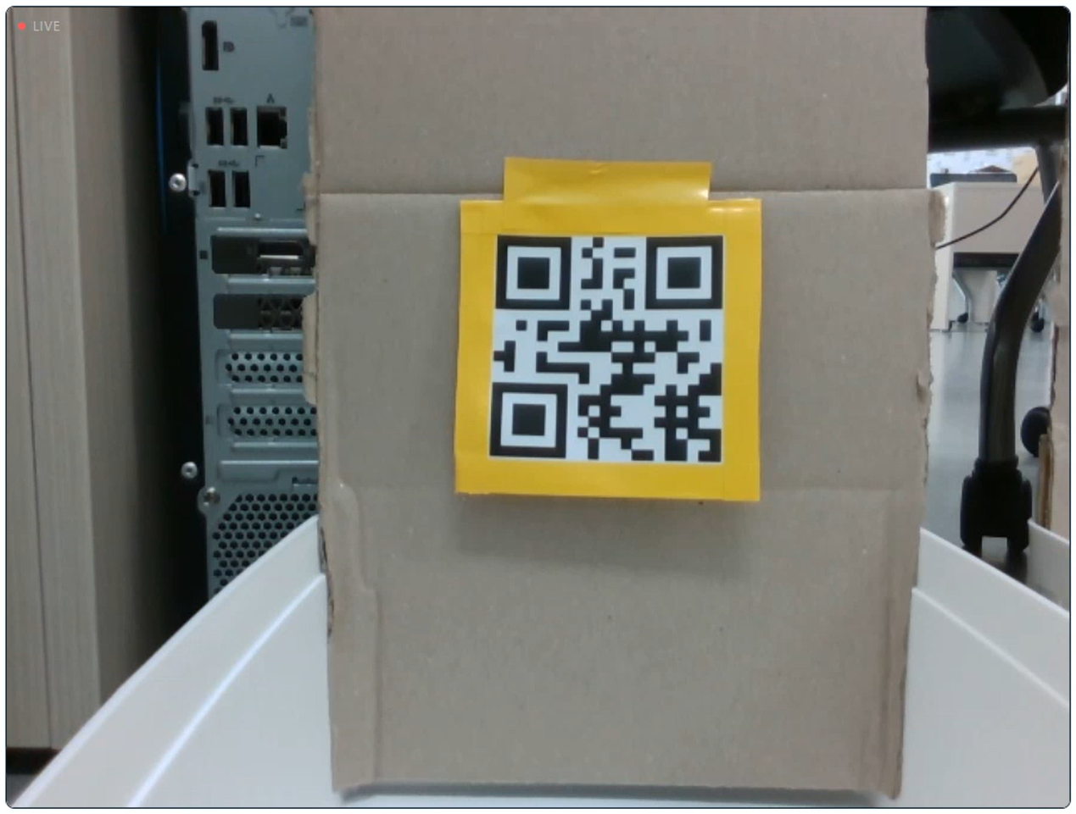
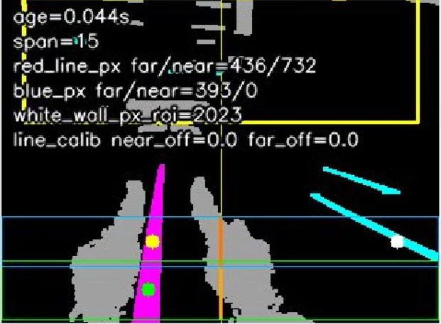
AGV 자율주행 SW 구조 및 주행 상태 전이 알고리즘
Distributed Software Stack
Core Algorithms
RGB-D
Image
Orin Perception
JSON
Jetson Tracer Node
Line / QR / Depth
Parking marker
→ JSON publish
Mission FSM
Navigation State
Decision Logic
01 Line Following
RealSense
color + depth
02 QR Arrival
line HSV segmentation
near/far ROI center 추정
linear.y 기반 횡보 보정
QR stop ROI 제한
bbox threshold
/cmd_vel_raw
AGV
Mobility
cmd_vel Safety Filter
Control I/O
accel limit / deadzone adapter
pulse duty / zero-cross guard
/stop_obj
/stop_qr
04 Safety Filter
03 Depth Rack Stop
cmd_vel_raw → cmd_vel
angular pulse duty
zero-cross hold + vx 제한
white-wall ROI
depth median + valid px
/cmd_vel
myAGV Driver / MCU
/cmd_vel hardware-safe command
OpenCV 영상 처리 사진
Navigation Behavior State Machine
/place_target
rack stop
/stop_obj
/picked
QR stop
/stop_qr
/placed
/go_parking
IDLE
Safe Wait
FOLLOW
line center + linear.y
EVENT GATE
QR / depth / marker / line lost
BEHAVIOR EXECUTION
CORNER · TURN_180 · JUNCTION · STOP_END · PARK_FORWARD
RESUME / WAIT
next behavior or external event
CORNER
odom yaw
JUNCTION
QR align
STOP_END
arrival
PARK
entry
LINE LOST
search/stop
Notes:
CORNER / TURN_180에서 odom yaw 기반 처리
일반 추종은 angular.z 대신 mecanum linear.y 보정

Slide 2
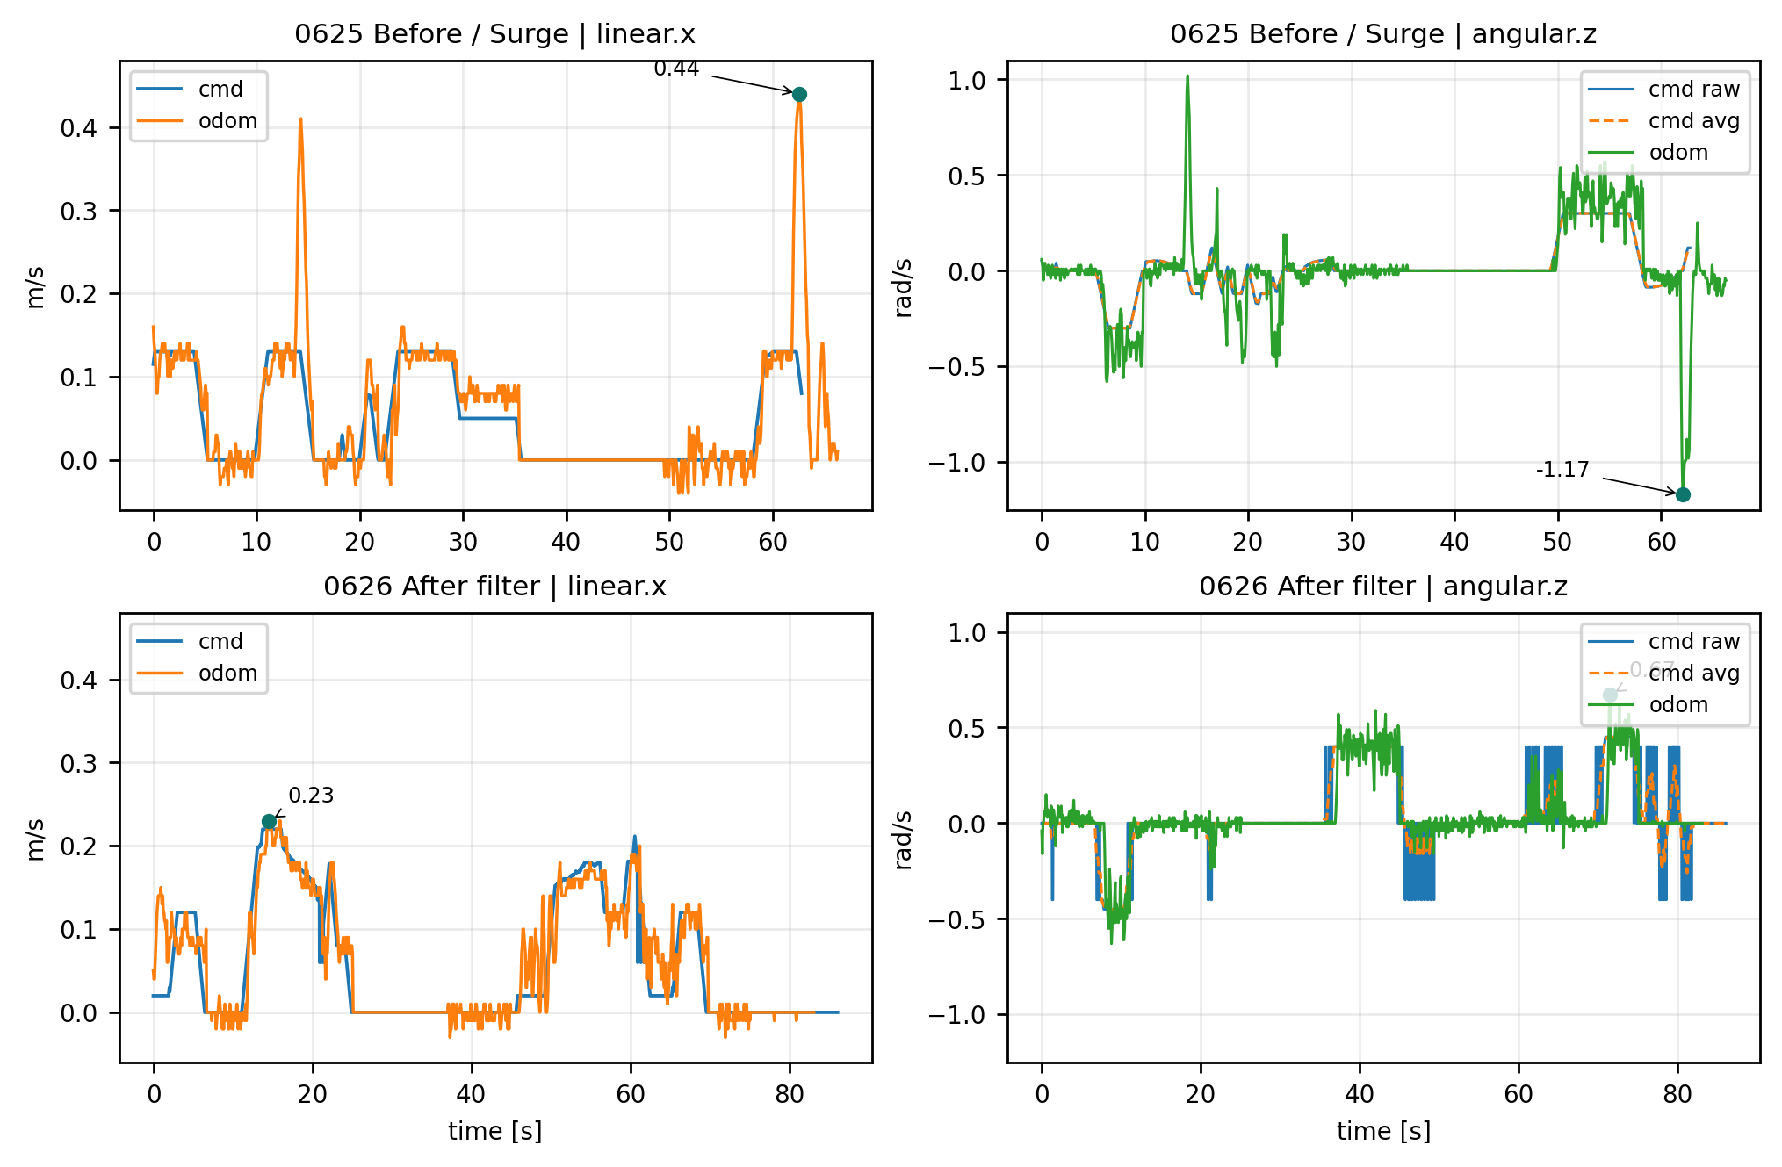
AGV 제어 안정성 KPI 검증
KPI Validation
Velocity Safety Filter 적용 전·후 /cmd_vel & /odom 정합성 및 overshoot 변화 분석
cmd_vel–odom tracking overlay
<NRMSE(normalized RMSE)>
 | NRMSE Before | NRMSE After
Linear.x | 46.8% | 17.6%
Angular.z | 76.3% | 28.0%
3.38배 증폭 출력
3.90배 증폭 출력
<Overshoot 초과량 및 초과율>
 | Before | After | 개선
Linear.x peak overshoot | 0.31 m/s | 0.01 m/s | -96.8%
Angular.z peak overshoot | 0.87 rad/s | 0.22 rad/s | -74.7%
1.49배 증폭 출력
1.05배 증폭 출력
Notes:
해석: safety filter는 순간 cmd_vel을 그대로 추종시키는 것이 아니라, myAGV 하위 구동계의 angular deadzone을 고려해 effective command로 변환하여 odom peak와 RMS error를 낮춘다.

